Slide 1

A Minor Project Report
PRESENTATION
STUDENT HELP DESK MANAGEMENT SYSTEM
SUBMITTED BY SUPER SUPERVISED BY
MOHD ARHAM DR. IMRAN HUSSAIN
2020-310-142
COMPUTER SCIENCE
SUBMITTED TO
Department of Computer Science & Engineering
School of Engineering Sciences & Technology
JAMIA HAMDARD

Slide 2
1). Abstract :-
The Student Helpdesk project is an online platform that facilitates communication between students and the university administration. The system provides a centralized location for students to submit queries related to academics, administrative issues, or any other concerns they may have.
The project aims to streamline the process of handling student queries and reduce the response time of the university administration. This report outlines the development process of the Student Helpdesk project, including the objective, problem statement, use case diagram, class diagram, entity relationship diagram, Gantt chart, and conclusion.

Slide 3
2). Objective :-
The Help Desk Management System is a set of programs which run as a software providing assistance to all the complaints, queries and services to the customers within a set of organization. It is a web based software which has made the working procedure of organization much easy.
This software will fulfill customer’s need by providing them technical support for their relevant issues as well as time period considered for solving the problems will be much shorter. All the queries and issues that will be posted in portal will be saved into the database for future reference.
The software is an intranet based software which can be used within the organization. It is basically a customer care management system. This software is very efficient in future time because it is an E-help desk system which tries to solve the problems of all the customer via internet medium and digital medium and thus reducing even the working time for the users too, to solve their problems and queries.

Slide 4
3). Introduction :-
A web-based student helpdesk system is an online platform that enables students to request academic, technical, and administrative support from their educational institution.
The system is accessible from anywhere with an internet connection, making it easier for students to receive timely assistance and improve their academic experience. Overall, a web-based student helpdesk system is a powerful tool that can enhance the academic experience for students and help institutions provide better support and services.

Slide 5
4). Problem Statement :-
The current process of handling student queries at our university is inefficient and time-consuming. Students are required to visit different departments and fill out physical forms to submit their queries. The university administration also lacks a centralized system to manage and respond to student queries. As a result, students face delays in getting their queries resolved, and the university administration is burdened with the task of manually managing a large volume of queries.
The objective of the Student Helpdesk project is to address these issues by providing a centralized platform for students to submit and manage their queries and for the university administration to respond to these queries in a timely manner.

Slide 6
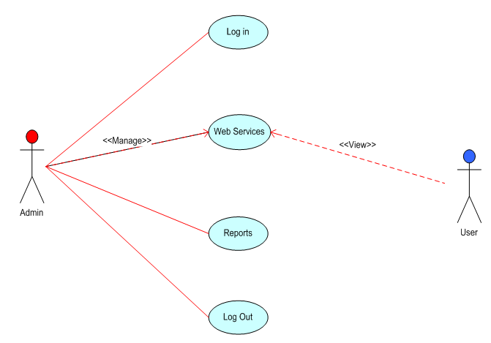
5). Use Case Diagram :-

Slide 7
6). Effort Estimation based on model :-

Slide 8
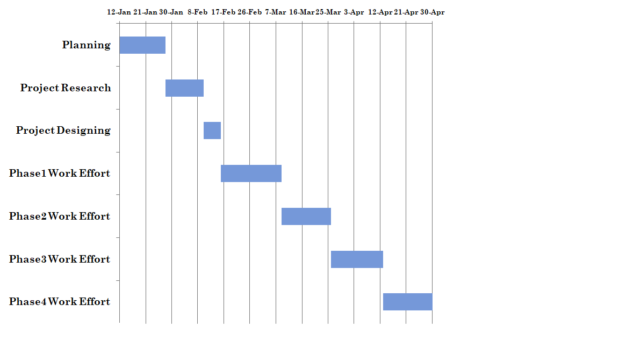


7). Gantt Chart :-
27-Jan

Slide 9
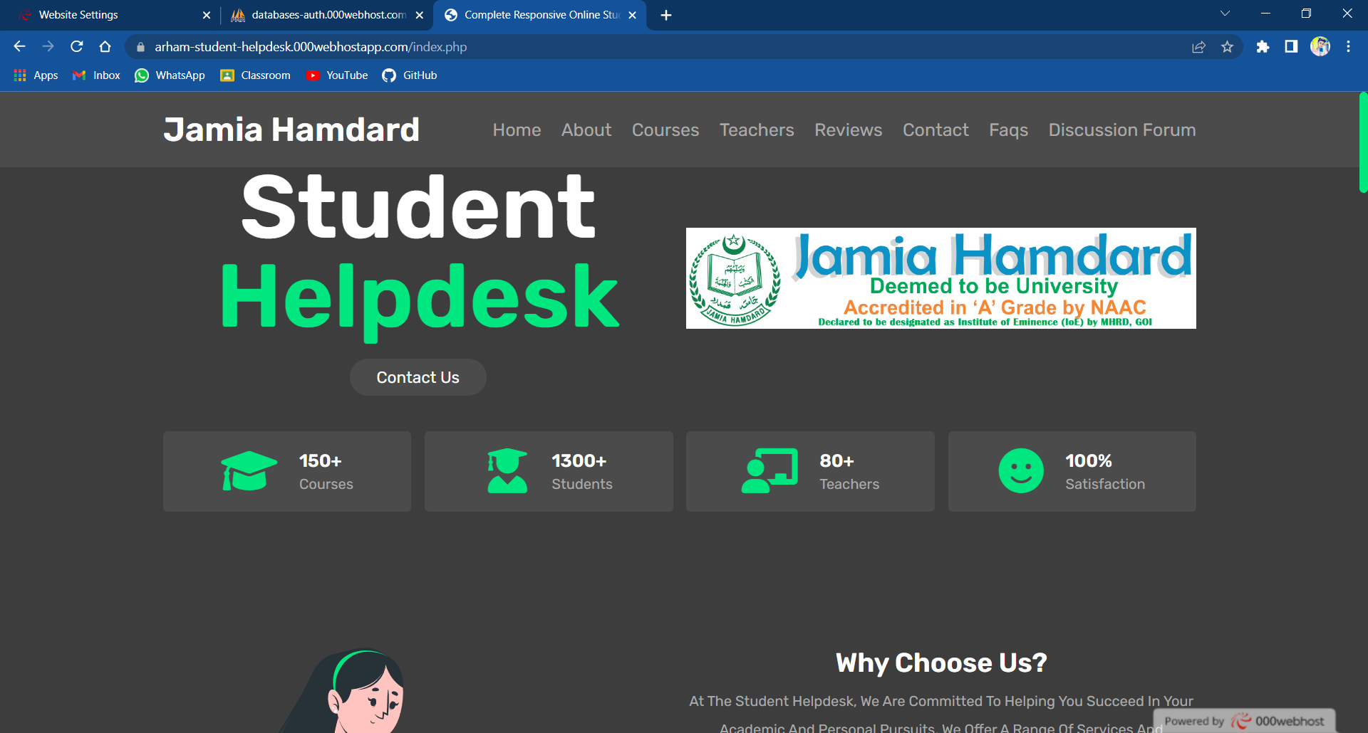
6). Snapshots :-

Slide 10
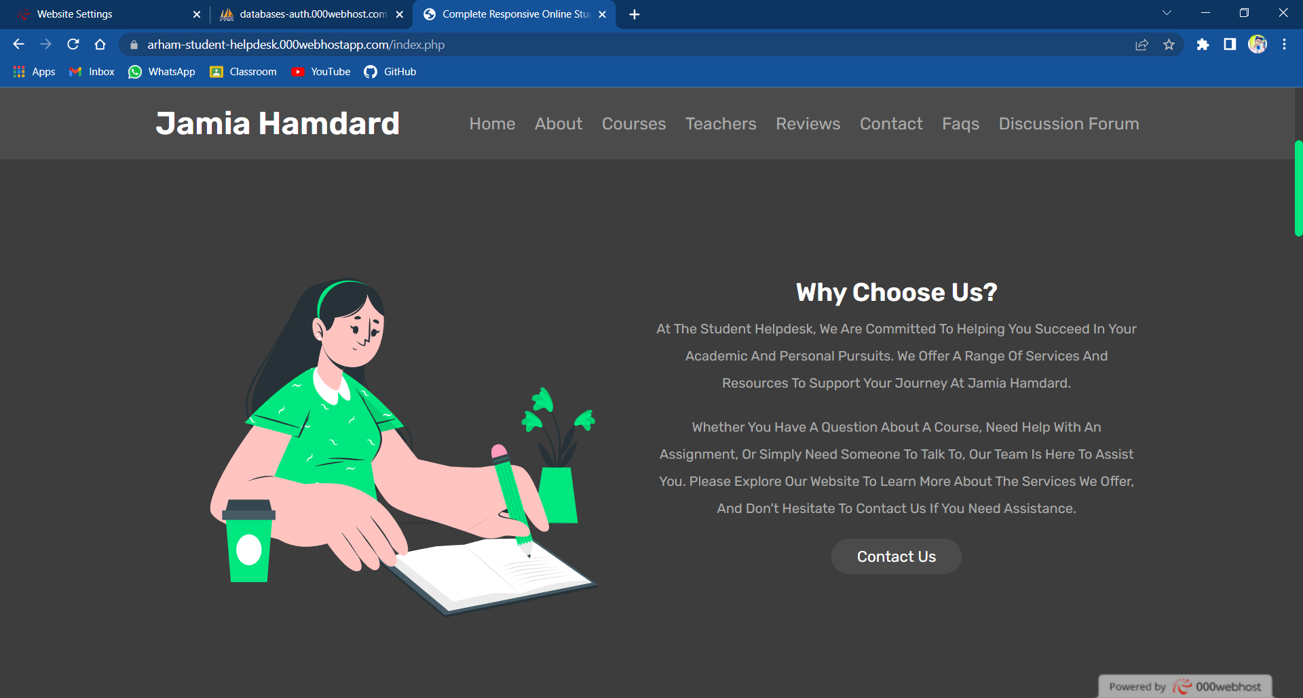
Snapshots

Slide 11
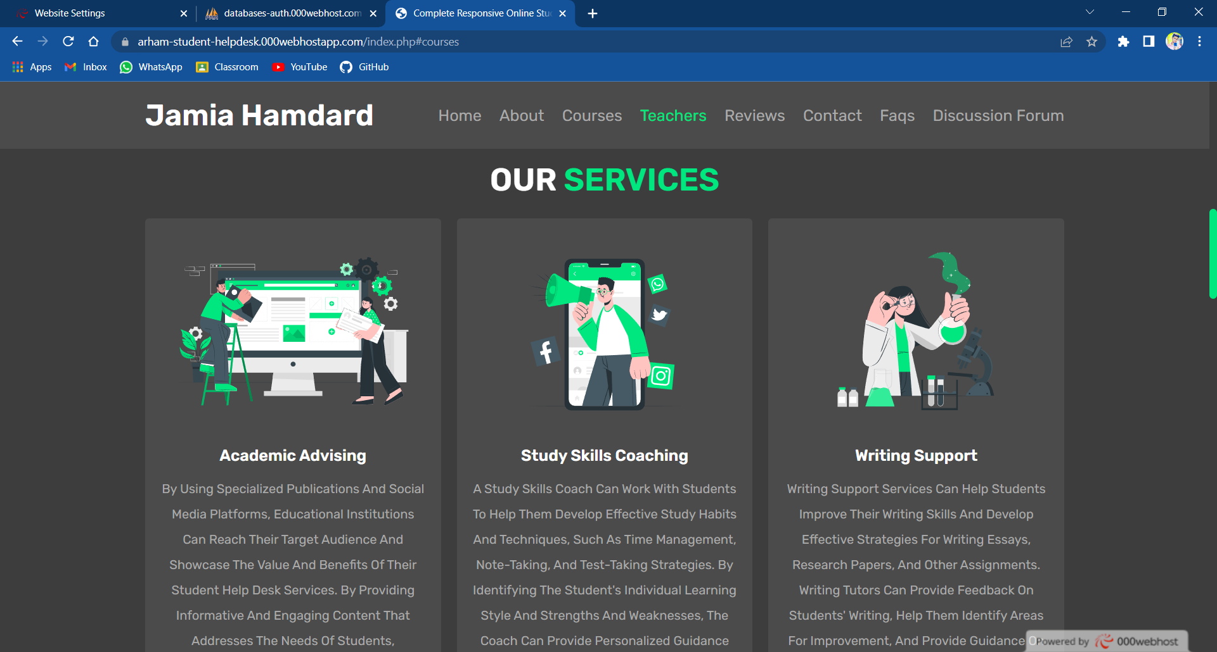
Snapshots

Slide 12
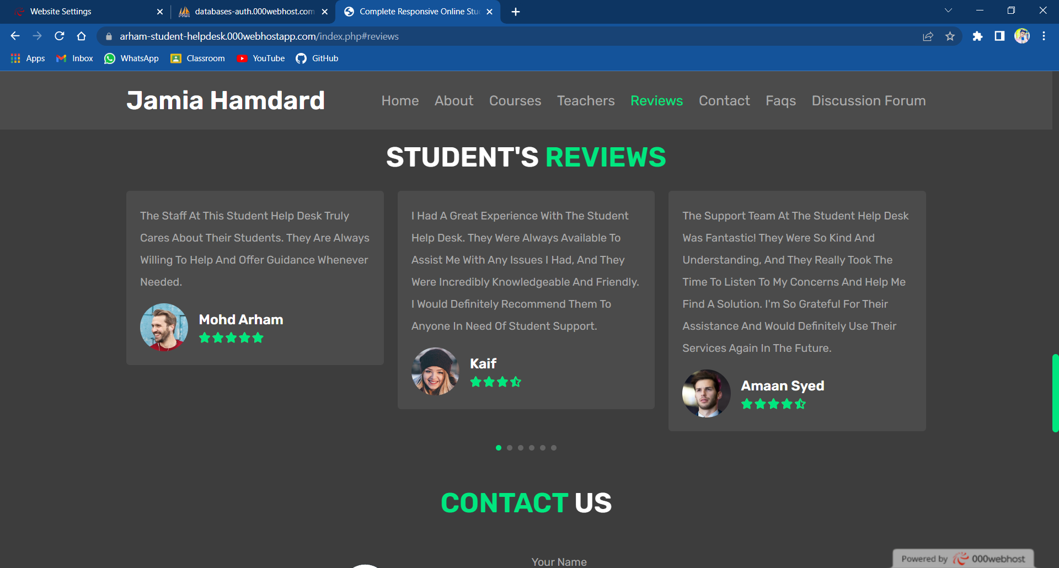
Snapshots

Slide 13
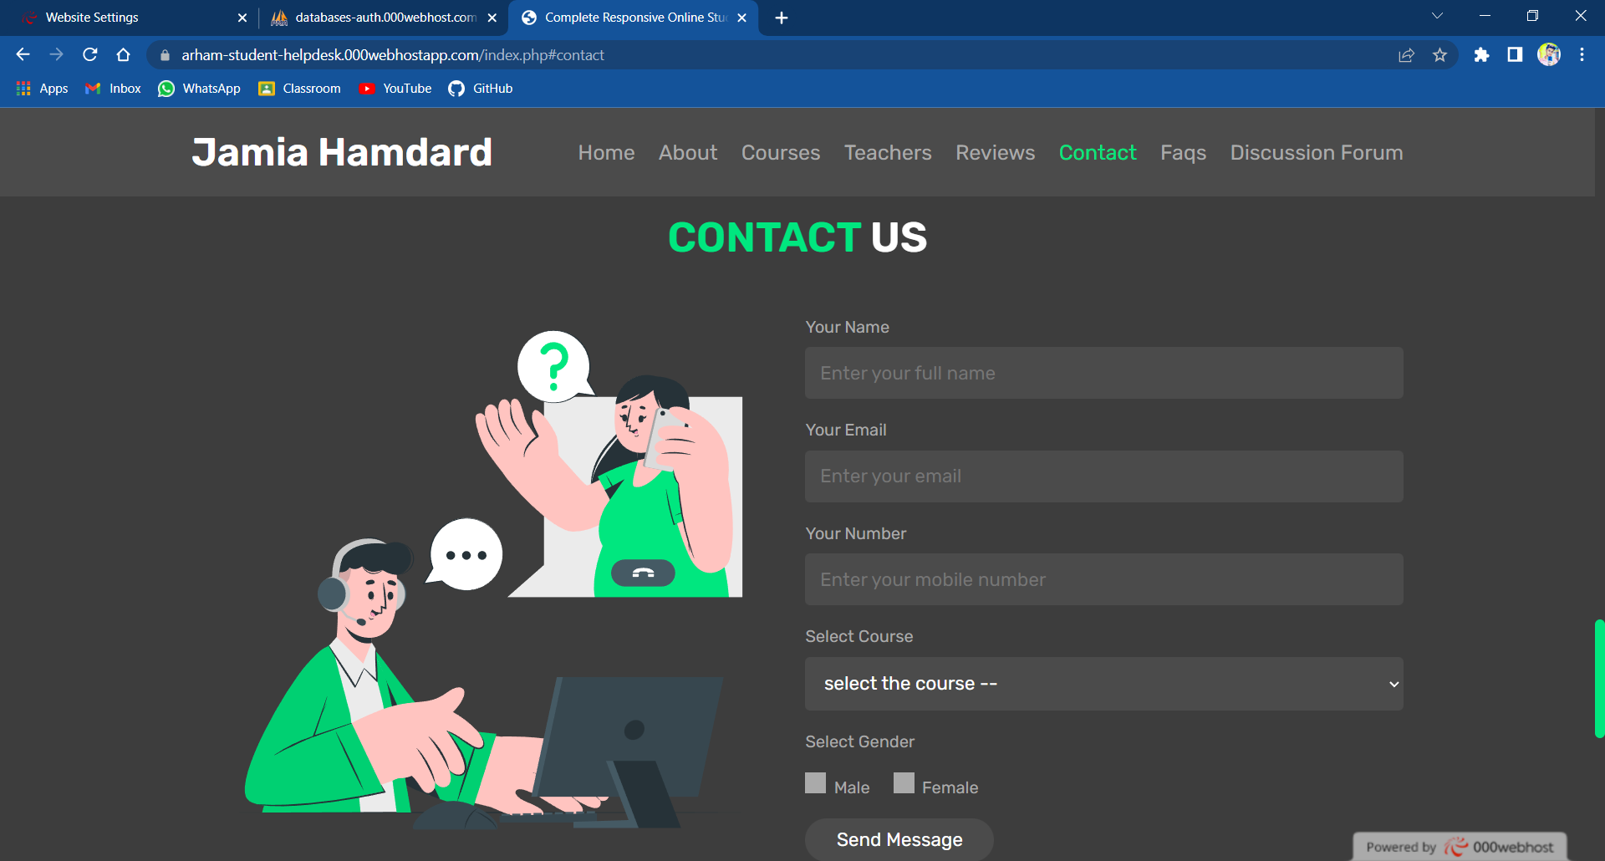
Snapshots

Slide 14
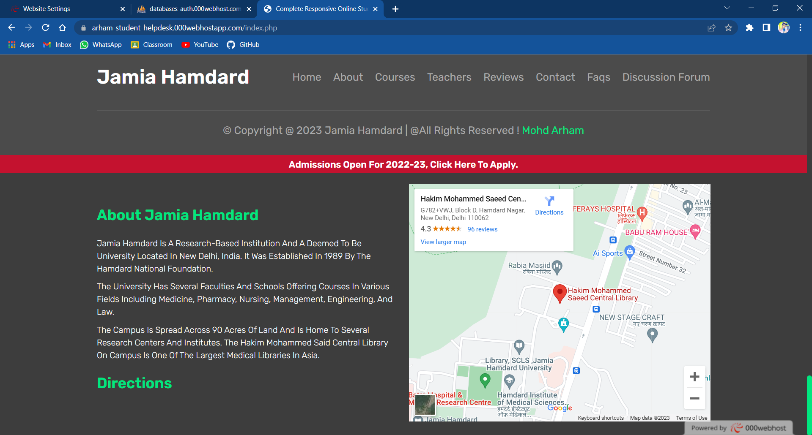
Snapshots

Slide 15
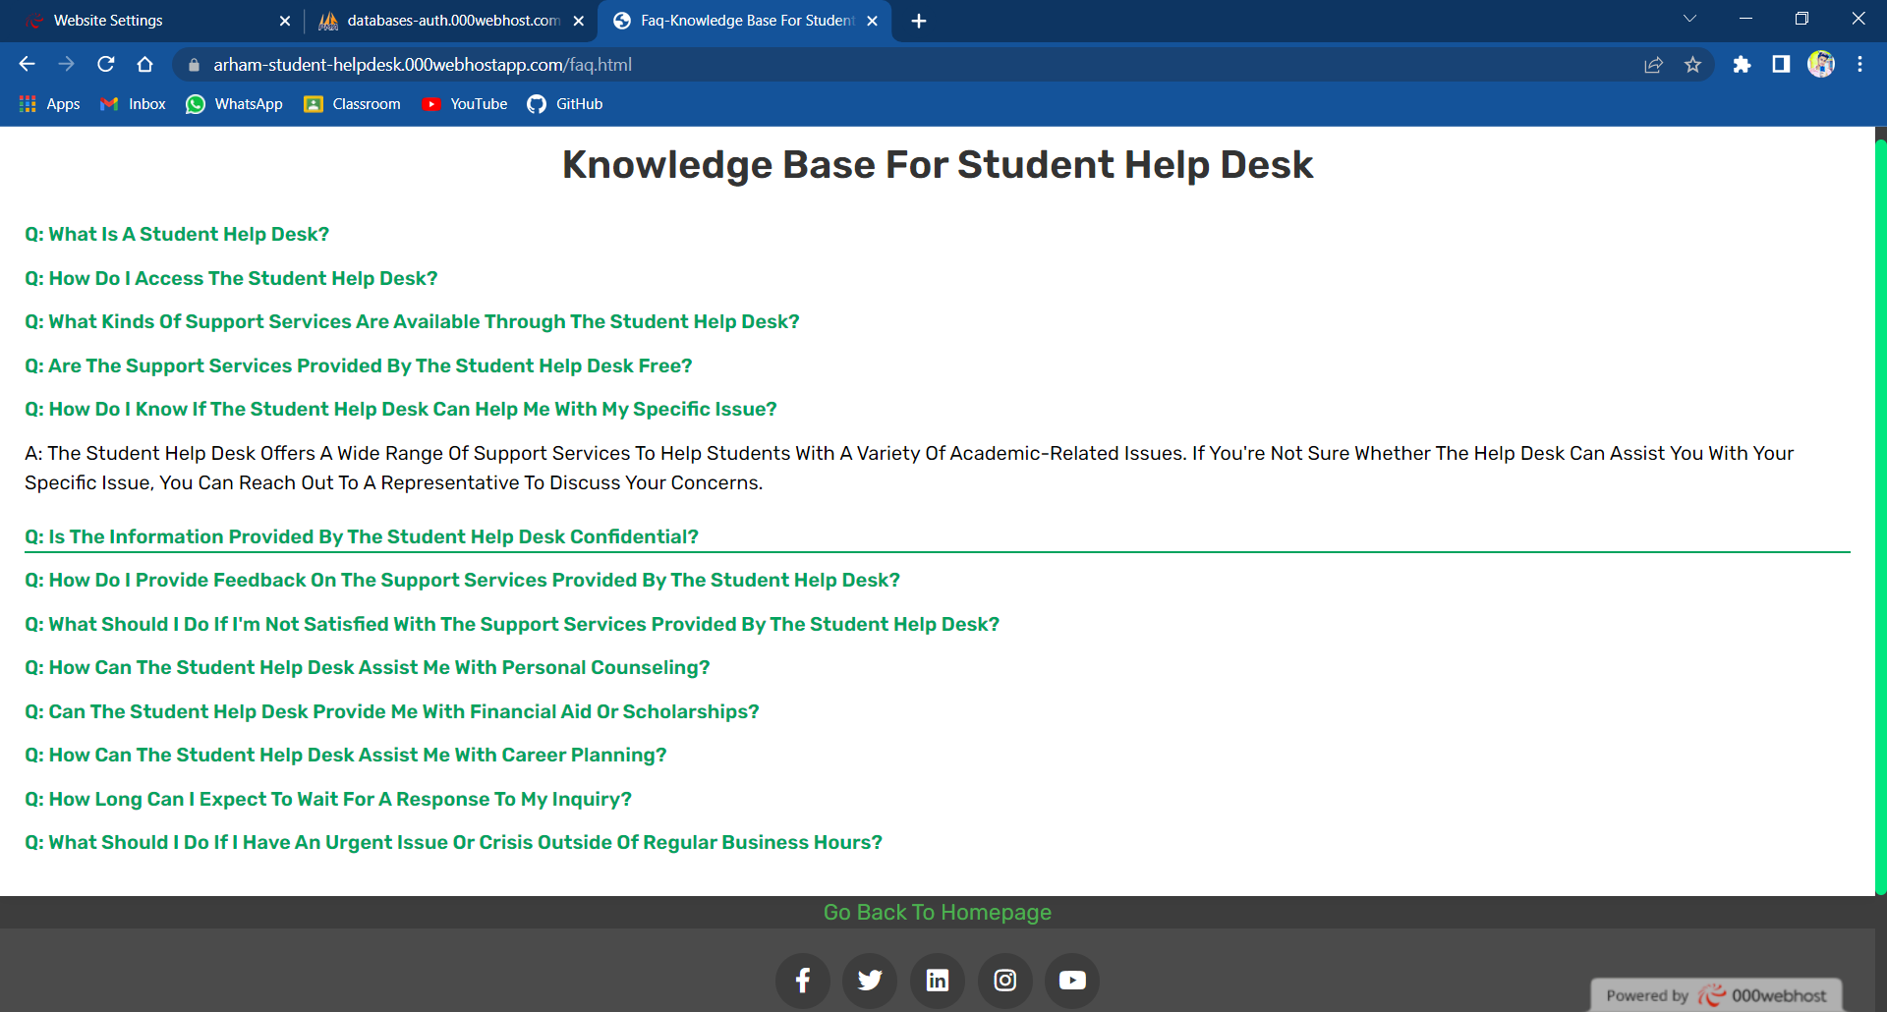
Snapshots

Slide 16
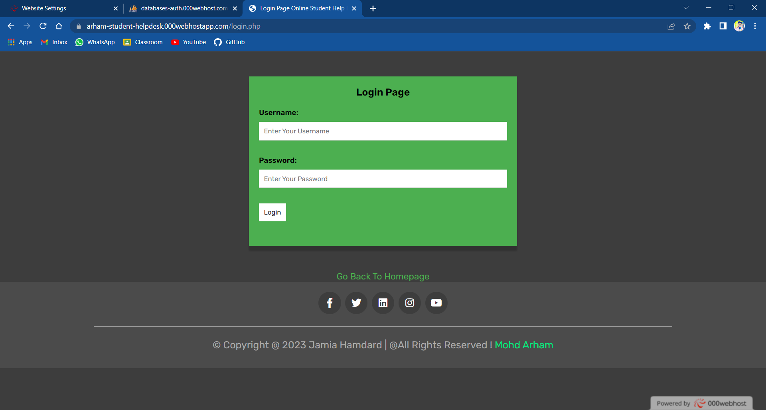
Snapshots

Slide 17
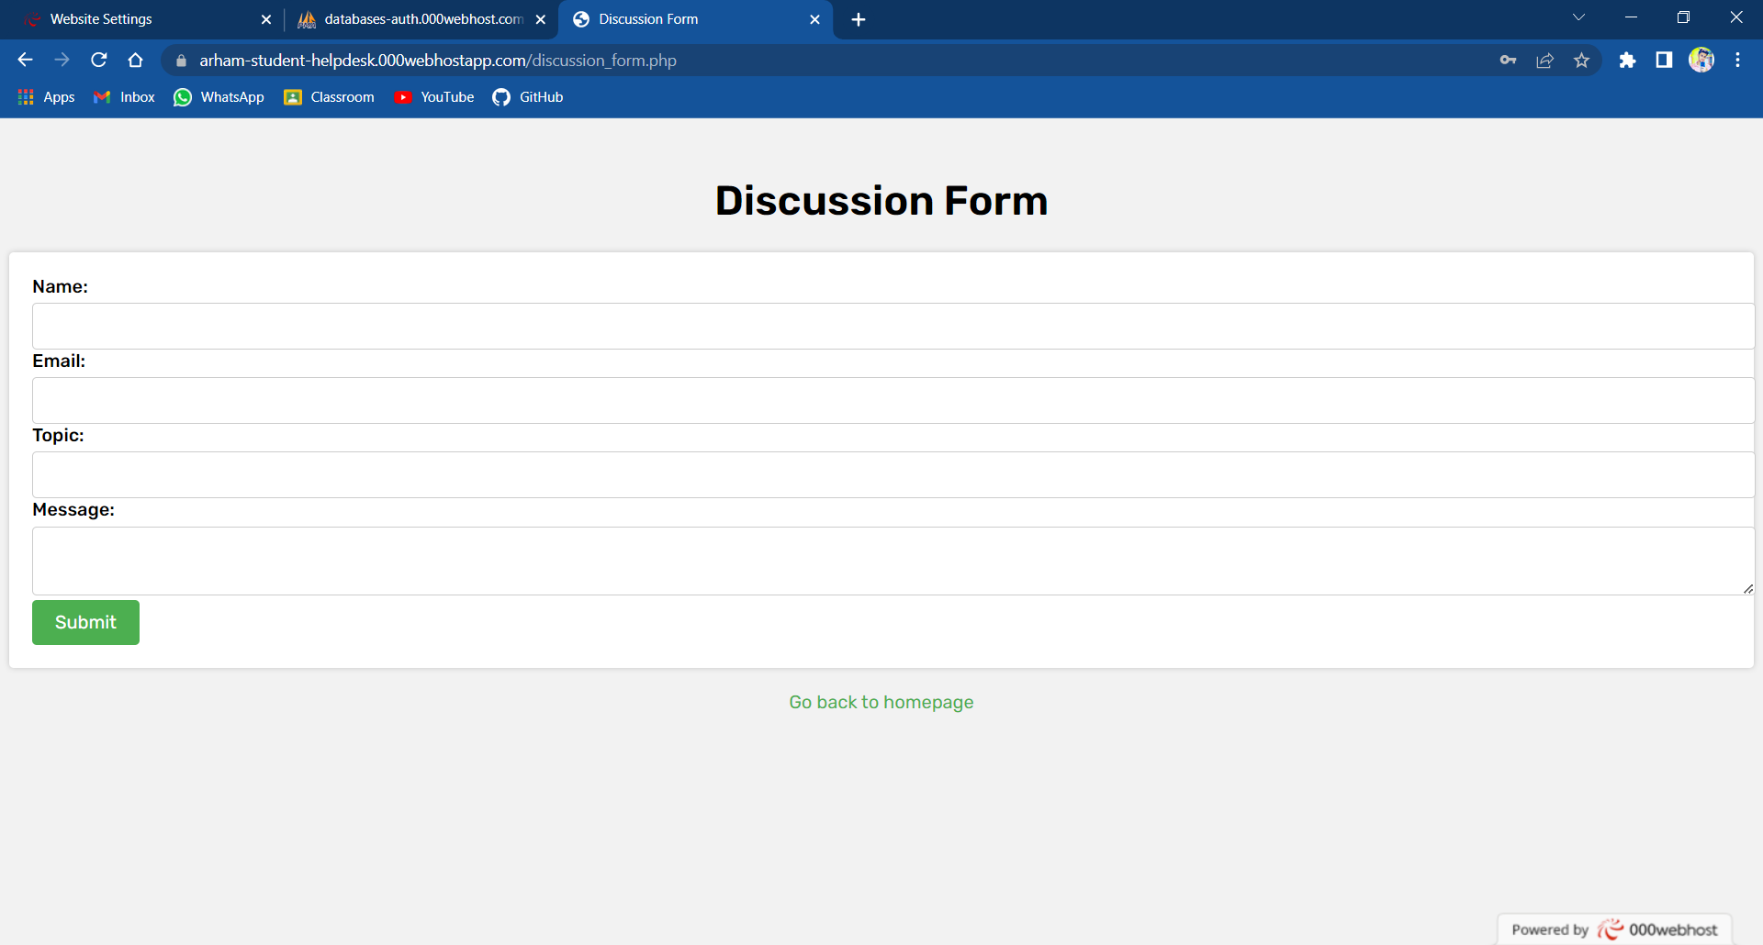
Snapshots

Slide 18
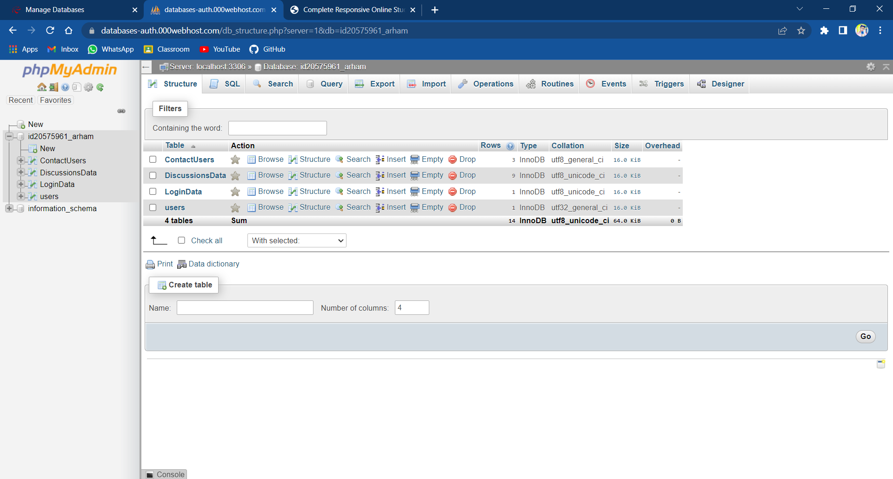
Snapshots

Slide 19
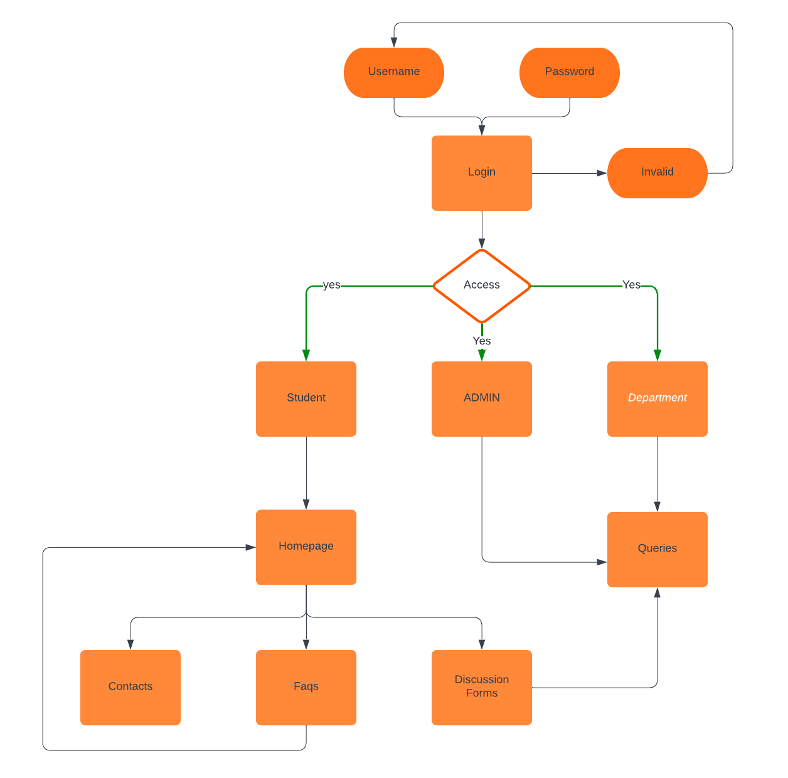
6). Entity Relationship Diagram:-

Slide 20
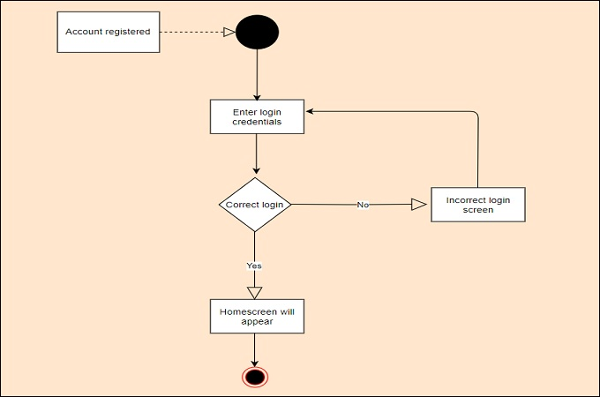
7). Activity Diagram

Slide 21
8). Conclusion
The Student Helpdesk project uses a combination of HTML, CSS, JavaScript, and PHP to create a user-friendly interface that allows students to request help and support from their educational institution. The project features support request handling, a messaging system, and analytics and reports to help staff members provide effective support and improve their performance.
Student Help Desk reduces the paper work, saves student precious time and solve student queries .
Student can access this application from anywhere via Internet, since the database is placed on server.
This idea of student help desk can be implemented by all other departments as well.

Slide 22
9). Limitations and Future Scope
Limitation
This Student Helpdesk Webpage has a login page which
allows only enrolled students of Department
of Computer Science to login and thereby
preventing unauthorized access.
Future Scope
Student Help Desk Website can be used by any
department of University.
The Application can be further enhanced and
several other functionalities can be added.

Slide 23
10). Bibliography
W3Schools. (n.d.).HTML5 Tutorial. Retrieved from https://www.w3schools.com/html/default.asp
Mozilla Developer Network.(n.d.).CSS. Retrieved from https://developer.mozilla.org/en-US/docs/Web/CSS
JavaScript. (n.d.). JavaScript Tutorial. Retrieved from https://www.javascript.com/learn/javascript/first-steps/what-is-javascript
PHP. (n.d.).PHP Tutorial. Retrieved from https://www.php.net/manual/en/tutorial.php
MySQL. (n.d.).MySQL Documentation. Retrieved from https://dev.mysql.com/doc/
Apache HTTP Server. (n.d.).Apache HTTP Server Documentation. Retrieved from https://httpd.apache.org/docs/
XAMPP. (n.d.).XAMPP Documentation. Retrieved from https://www.apachefriends.org/docs/

Slide 24
THANK YOU
WEBSITE LINK:-
arham-student-helpdesk.000webhostapp.com

